Slide 1
Computer Software
Instructor: Saba Iqbal

Slide 2
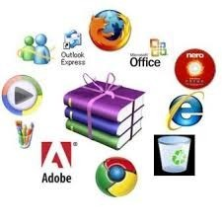
What is a Computer Software?
Computer software, or simply software, is a collection of data or computer instructions that tell the computer how to work.
This is in contrast to physical hardware, from which the system is built and actually performs the work.
Examples
Ms word, excel, power point, spread sheets, management system etc.
Notes:
How presentation will benefit audience: Adult learners are more interested in a subject if they know how or why it is important to them.
Presenter’s level of expertise in the subject: Briefly state your credentials in this area, or explain why participants should listen to you.

Slide 3
Hardware vs Software
H/W includes the physical parts of a computer, whereas , software is the set of instructions that can be stored and run by hardware.
They are complementary to each other
Same H/W may perform different jobs using different S/W
Hardware is so-termed because it is "hard" or rigid with respect to changes, whereas software is "soft" because it is easy to change.
S/W(Software) makes H/W(Hardware) usable by directing to execute any command or instruction.
A combination of hardware and software forms a usable computing system.

Slide 4
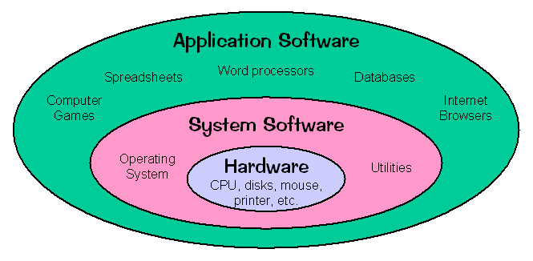
Types of Software
System Software
Application Software

Slide 5
Types of Software
System Software
Program or set of program that are specially designed to operate, control, and extend the processing capabilities of a computer system.
System software serves as the interface between the hardware and the end users.
It controls the working of different parts of computer.
It enables other application programs to work properly

Slide 6
System Software
Example
The examples of system software are:
Operating System
Utility Program
Device Drivers

Slide 7
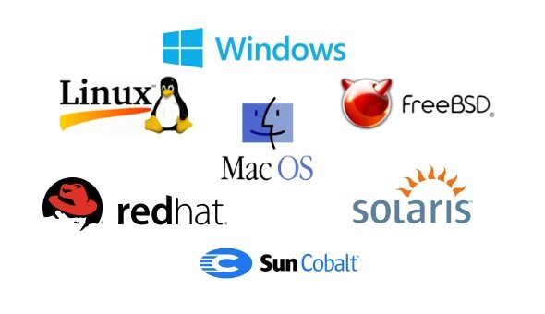
Operating System
An operating system is a collection of program that controls and co-ordinates the overall operation of a computer system
These programs provide interface between the user and the computer system
A computer needs an operating system to do work, without operating system it is like a car with no fuel.
An application program cannot access I/O devices or execute program instructions itself. The operating system performs these tasks through CPU on behalf of application programs

Slide 8
Operating System
Operating system performs following tasks such as;
Accepts input from input devices
Sends output to output devices
Manages the application program in memory
Manages the files on the storage devices
Manages and controls the I/O devices etc.

Slide 9
Utility Programs
A software which is manufactured to help ,analyze, configure, optimize or to maintain a computer.
Some utility programs are;
Diagnostic utility program
Disk Scanner
Backup utility
Virus-detection and recovery utilities
File-compression utilities
Spam and pop-up blocker utilities

Slide 10

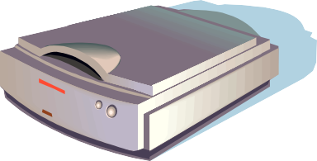
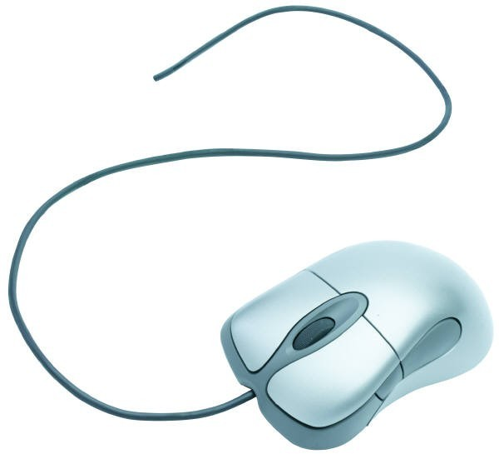
Device Drivers
The programs that operate and control the devices attached to the computer are called device drivers
Attached devices needs a software that tells the computer how to use the device
It loads every time in memory.
When a new device is added the driver should be installed in order to run the program

Slide 11
Features of System Software
Close to system
Fast in speed
Difficult to design
Difficult to understand
Less interactive
Smaller in size
Difficult to manipulate
Generally written in low level language

Slide 12

Types of Software
Application Software
Designed to solve a specific problem or to do a specific task.
It can be of different types such as; commercial software, scientific software, Games and multimedia software etc.

Slide 13
Application Software
Categories of Application Software
Types of Application
Forms of Application Software

Slide 14
Types of Application Software
Proprietary
In-house
Contract
Off-the-shelf

Slide 15
Types of Application Software
Proprietary
Proprietary software is a licensed (non-free) software under exclusive legal right of owner.
In-house
In In-house software we develop application with the help of company resources
Off-the-shelf
An existing software program that can be used without any changes expected.
Contract
The software which is developed for a specific company for their requirement.

Slide 16
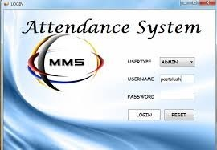
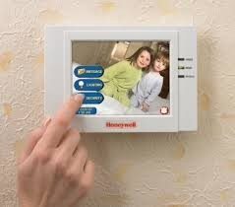
Forms of Application Software
Custom-built software
It is developed for a particular organization or customer, known as customized software
For example, software developed to
Maintain the records of students at a particular institute.
Attendance system
Security code system.

Slide 17
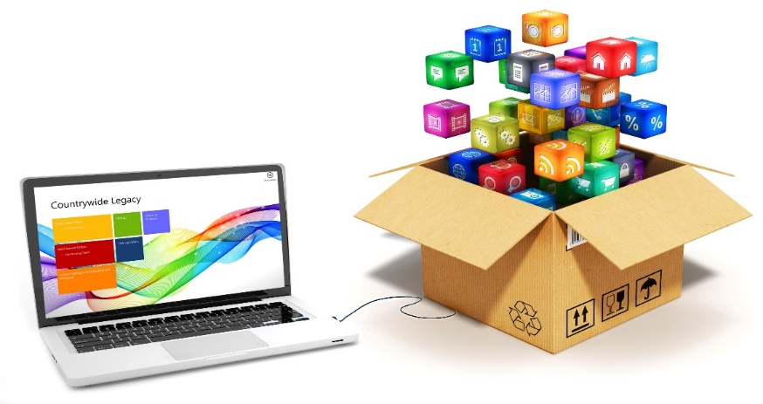
Forms of Application Software
Packaged software
The software that is developed by software development organizations( or any programmer) for sale to the general public.
It is used to solve some common problems of many users
The examples of packaged software are:
Word processing software
Spreadsheet software
Database management software
Presentation software
Graphics software

Slide 18



Web Application
A web application is any application that uses a web browser.
Example
Google docs
Drop Box
Google Classroom

Slide 19
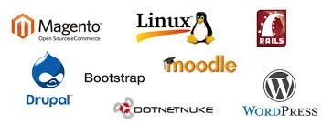
Open-Source Software
The term "open source" refers to something people can modify and share because its design is publicly accessible.
Open-source software is a type of computer software in which source code is released under a license in which the copyright holder grants users the rights to study, change, and distribute the software to anyone and for any purpose.
Example
Linux
Moodle
WordPress
Drupal

Slide 20
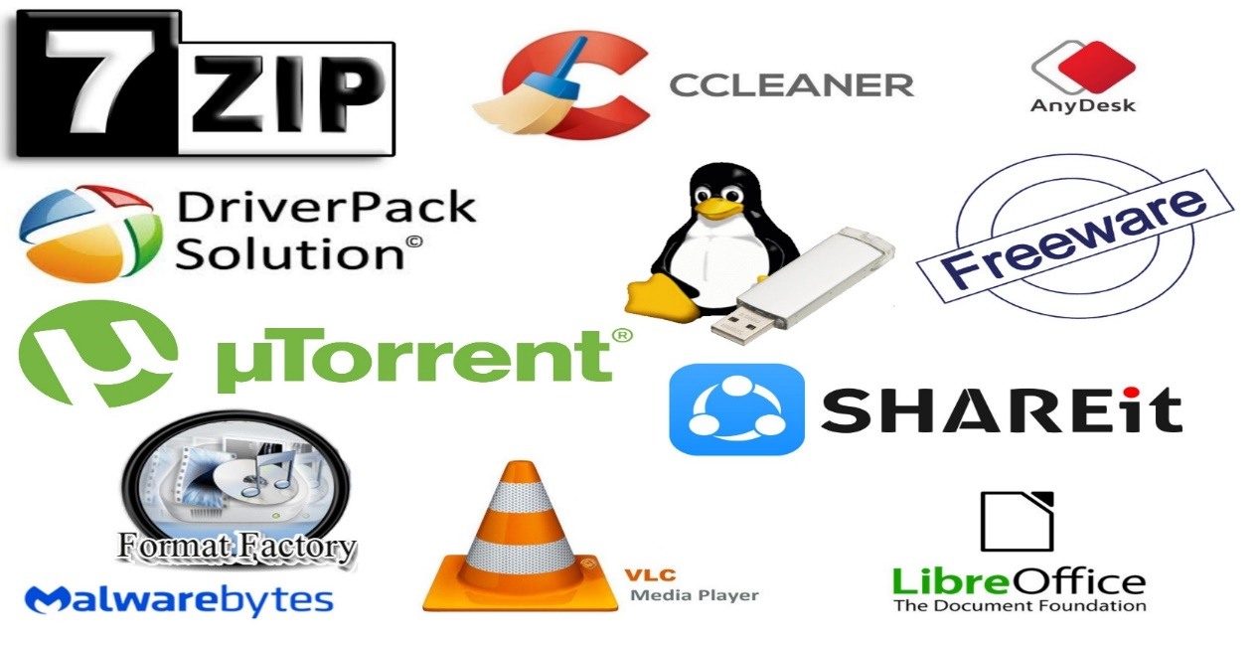
Free ware
Free ware is the software that is freely available to public, but author has a copy right, means that you can only use it ,not sell it.
Example
Antivirus
Adobe Reader
Free Studio
Skype

Slide 21
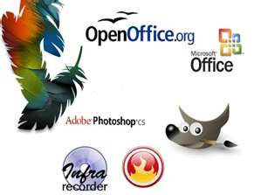
Share ware
Share ware is actually delivered free of charge but some time the owner ask for money to get registered, so that they can send updates in future. It can be copied but cannot be sold.
Example
Microsoft office
WinZip.
Adobe Photoshop
Adblock Plus.

Slide 22
End Lecture

